Slide 1
Career Waypoints (C-WAY)
Professional Apprenticeship Career Track (PACT)
Notes:
Time Required: 100 min

Slide 2
Enabling Objectives
STATE the purpose of Career Waypoints
LIST the personnel impacted by the Career Waypoints process
IDENTIFY the Career Waypoints modules
LIST the Career Waypoints options provided to the Sailor
ASSESS the Career Waypoints timeline requirements
EXPLAIN the PACT Marketplace process
EXPLAIN the submission process for 4-2-2 Sailors
Notes:
FACILITATOR GUIDE:
Review objectives.

Slide 3
REFERENCES
NAVPERS 15560D: Navy Military Personnel Manual
MILPERSMAN 1160-140: Career Waypoints
MILPERSMAN 1001-260: Targeted Re-Entry Program (TRP)
NAVPERS 15878N: Career Counselor Handbook
Career Waypoints (CWAY) User Guide
Career Waypoints PACT Marketplace Submission Schedule (FY)
Notes:
FACILITATOR GUIDE:
Review references.

Slide 4
REFERENCES
(cont.)
MILPERSMAN 1306-611: Professional Apprenticeship Career Track (PACT)
DCNO SIGNED MEMO SER N1/114087: Military Service Obligation
MILPERSMAN 1236-010: Armed Forces Classification Test (AFCT) Administration and Procedures for Navy Personnel
MILPERSMAN 1306-1501: Enlisted Active Component to Reserve Component (AC2TAR/AC2SELRES) Eligibility Requirements and Application Procedures
Notes:
FACILITATOR GUIDE:
Review references.

Slide 5
CAREER WAYPOINTS
(CWAY)
CWAY PURPOSE:
Controlling enlisted rating entry standards
Providing Sailor qualifications for My Navy Assignments (MNA) marketplace to best place Sailors into billets and/or conversion into desired rate
Execute all distribution and obligated service (OBLISERV) transactions
Notes:
FACILITATOR GUIDE:
Career waypoints (CWAY) is a force shaping tool which assists with balancing manning across rates, ratings through BUPERS control of reenlistment and enlistment contract extension quotas.
It provides conversion opportunities within MNA
NOTE: Sailors can now apply for conversion in the Marketplace located in My Navy Assignment (MNA). (preferred method)

Slide 6
CAREER WAYPOINTS
Guidance
All Sailors E1-E9 must be qualified in C-Way upon reporting to the command
    CCC's can utilize NAVPERS 1040/4 (Rev 07-2024)
  E1-E9 must be recommended for retention to apply for OBLISERV within MNA
Active Duty Sailors can apply to affiliate with the Selected Reserves between 10 and 3 months prior to their SEAOS
    E3-E6 Sailors with less than 14 years of service
Notes:
FACILITATOR GUIDE:
CWAY is also where you go if a Sailor decides to transition from Active Component to Selective Reserves or vice versa.

Slide 7
CAREER WAYPOINTS
Guidance (cont.)
Selected Reserve Sailors
      Can apply for lateral conversions
      Apply to change from Reserve Component to Active Component (RC2AC program)
Review and/or submit applications for all required personnel monthly
Update your Sailor’s career intentions and applications appropriately
Ensure PACT Marketplace is updated with Sailor's intentions prior to submission deadline
Encourage Sailors to use the CEM function and complete the Job Opportunities In the Navy (JOIN) survey to assist them in getting desired jobs
Notes:
FACILITATOR GUIDE:
Each Sailor attached in your command be must be QUALIFIED in CWAY.
Deadline for application submission is 2359 Central Standard Time on the last day of each month. As the CCC, ensure to check all your CWAY application browser to ensure that there nothing is generated in CWAY prior to that date. (e.g., If a servicemember loses Security clearance, the Sailor may get flagged in CWAY and an application might revert requiring your attention.)
Use NAVPERS 1040/4 (Rev 07-2024) to validate medical eligiblity and requirements. (Recommend using form for qualification to validate vision and other medical requirements)
JOIN Survey: Available for member to take via BOL results are populated in CWAY.

Slide 8
CAREER WAYPOINTS
Timeline
Targeted Reentry Program (TRP) applications must be submitted 16-4 months from SEAOS
C-WAY automatically generates SELRES applications for 4-2-2 Sailors starting at 11 or 12 months from SEAOS
The 4-2-2 SELRES submission window is 10 to 3 months from SEAOS
Non 4-2-2 SELRES window is 10 to 3 months from SEAOS
PACT Sailors will begin applying for billets 12-months prior to their projected rotation date (PRD)
Some rating communities require special screening packages 13 to 16 months prior to PRD, for example, LN, AW, RP, MA, SO, submarine, EOD, ND, Information Warfare
Notes:
FACILITATOR GUIDE:
Timelines must be met in order to apply Sailor for specific intentions. Once outside of the window that opportunity is gone and they will have to work with CTO.

Slide 9
Armed Forces Classification Test (AFCT)
MILPERSMAN 1236-010
Improving ASVAB/AFCT Scores:
CO authorization
Must show academic improvement by completing one of the following before retaking:
  Highschool diploma, GED, or passed the U. S. citizenship test
  EBSCO Learning Express
  OASC
  Complete a college or correspondence course
New scores will be updated in the Enlisted Master File after processing
The new AFCT test score is final and will replace the current ASVAB/AFCT test score
Taking the AFCT via another service testing site (Army, Airforce) does not update Navy EMF and will require CCC action to update
Notes:
FACILITATOR GUIDE:
AFCT test results will be available in member's NSIPS within 30 days of testing. Personnel may retake the AFQT no less than 30 days from last test.
NOTE: The new AFCT score will overtake the current score.
Know the Command policy and procedures for testing.

Slide 10
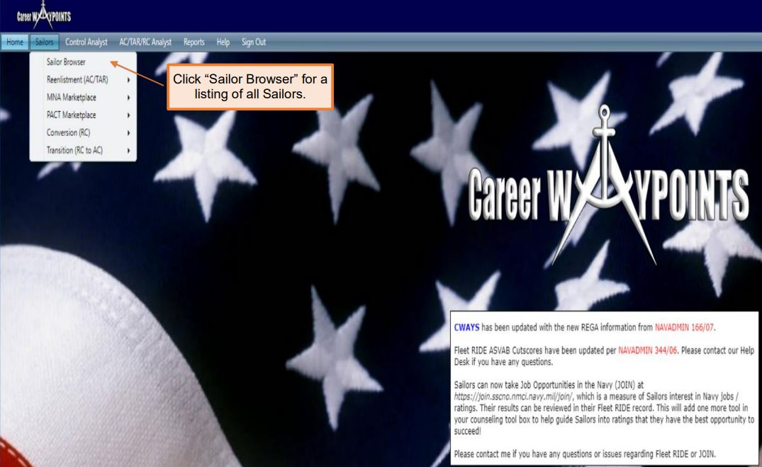
CAREER WAYPOINTS
Browser
Notes:
FACILITATOR GUIDE:
1. Once logged into the home page for CWAY, (found on BOL) in the middle of the screening CWAY populates notes, i.e. if a specific month reenlistment results have been released or any other important information.
2. To pull individual Sailors, hover over Sailors, Sailor browser and find Sailor (listed in alphabetical order based off last name). To get to the reenlistment applications prepopulated for the month, hover over Sailors, reenlistment then click reenlistment application browser. Here you can see which Sailors' applications have been submitted. You can change the from/to date to a single month and click on the refresh button highlighted in blue.

Slide 11
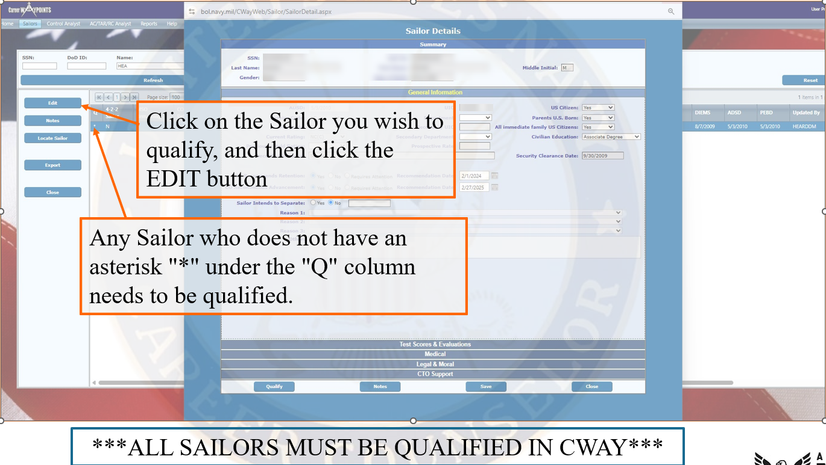
CAREER WAYPOINTS
Qualifying Sailors
Notes:
FACILITATOR GUIDE:
Each Sailor must be qualified in CWAY in order for the system optimization properly work. Ensure you are screening.
1. To qualify or manually input a reenlistment application, hover over Sailors, Sailor browser, find Sailor you are looking for, highlight in blue then click edit on left hand side. On this screen you will click on and ensure all information is correct for general information, test scores and evaluations, medical, legal & moral, and CTO (this portion you will leave blank unless a Sailor is close to separating and a CTO (Career Transition Officer) has been assigned.
Once updated and verified click on qualify (lower left corner). You will know if a Sailor is qualified or not, by going back to Sailor, Sailor browser. Here you will see the listing of all of your Sailors; there will be an asterisk (*) on the left side next to all Sailors who are qualified.
If you need to manually input a reenlistment application for a Sailor, you will go back to this screen and instead of clicking "qualify" click on apply reenlistment.

Slide 12
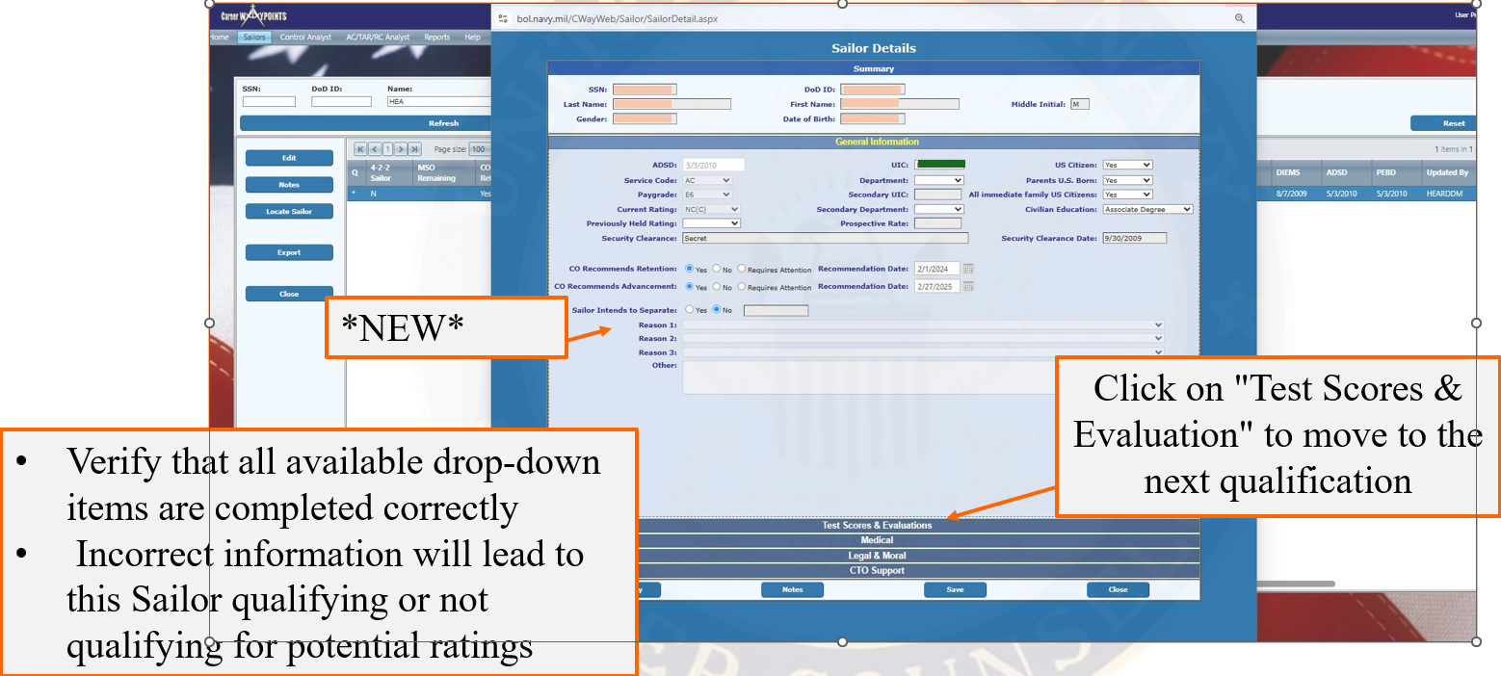
CAREER WAYPOINTS
Qualifying Sailors (cont.)
Notes:
FACILITATOR GUIDE:
Each Sailor must be qualified in CWAY in order for the system optimization properly work. Ensure you are screening.
Go through each tab (Test Scores & Evaluations, Medical, etc), and ensure that the information is current and up-to-date before hitting Save; then Qualify.
Refer to the 2024 CWAY User Guide (page 18-23) for more examples and further guidance.

Slide 13
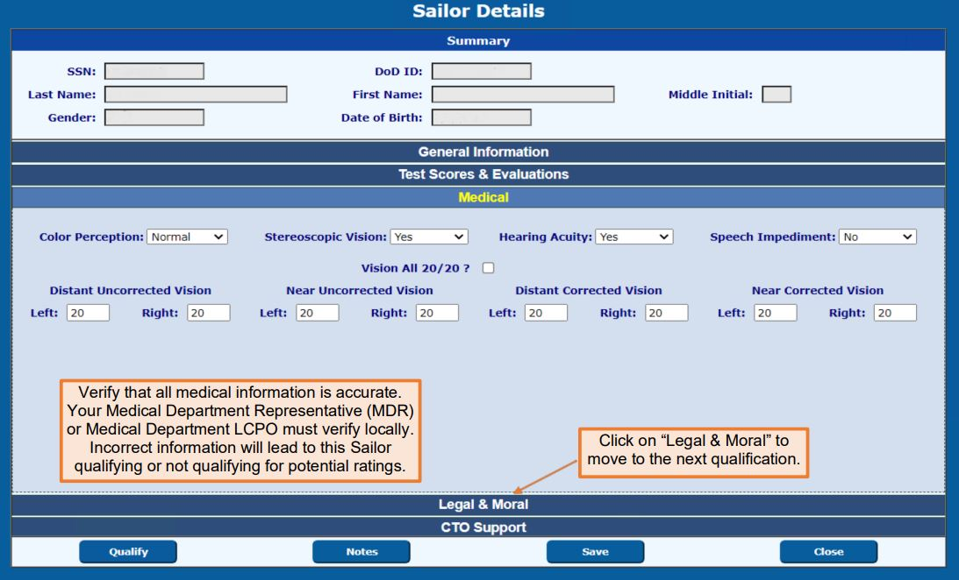
CAREER WAYPOINTS
Qualifying Sailors (cont.)
Notes:
FACILITATOR GUIDE:
None

Slide 14
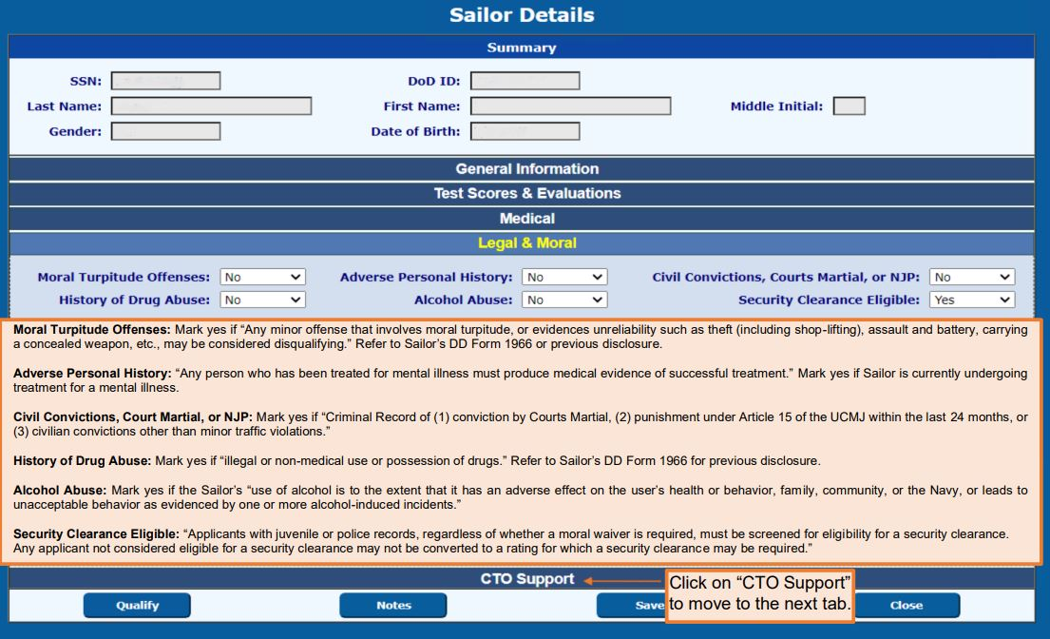
CAREER WAYPOINTS
Qualifying Sailors (cont.)
Notes:
FACILITATOR GUIDE:
None

Slide 15
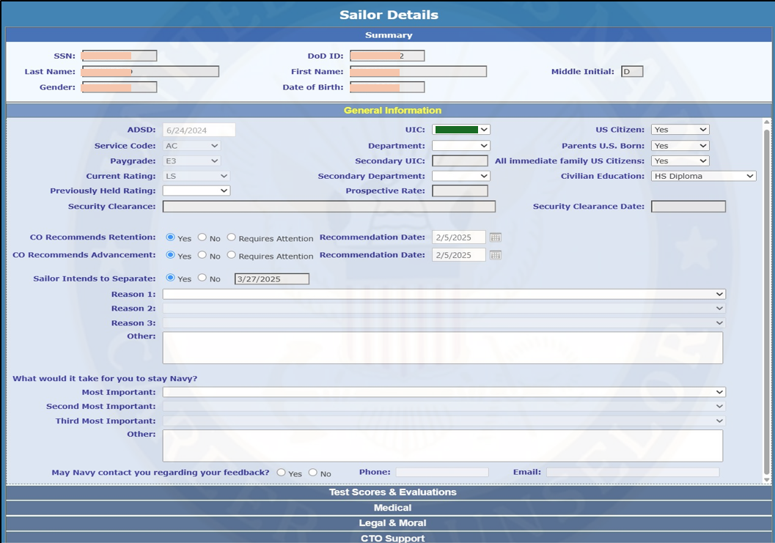
CAREER WAYPOINTS
Updating Sailor Career Intentions
Notes:
FACILITATOR GUIDE:
None

Slide 16
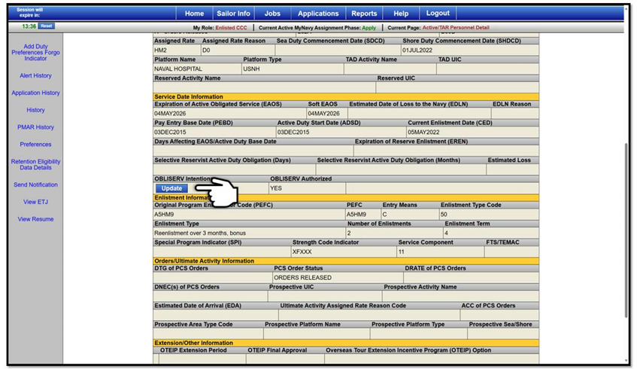
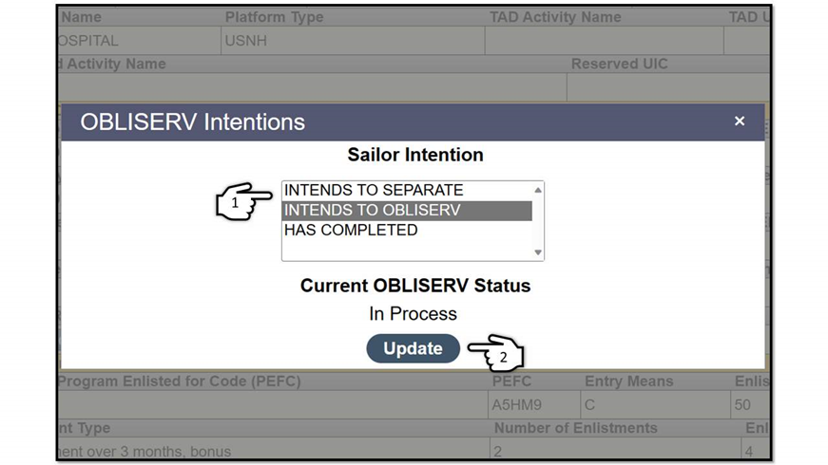
MyNavy Assignment (MNA)
Quota Validation
CCC submits the OBLISERV request in MNA 12-4 months from SEAOS under personnel details page by clicking the "UPDATE" button
Members outside the 12-month window submit their own requests via their self-service access
CWAY is used to validate all requests made via MNA after 24 hours of request

Slide 17
CAREER WAYPOINTS
SELRES Applications
AC and TAR Sailors who wish to transition to Selected Reserve (SELRES) must apply via CWAY:
  After making the "Intends to Separate" election in MNA.
  After marking "Intends to Separate" on the Sailor's CWAY profile.
Sailors under 90 days must submit their requests via NAVPERS 1306/7 (Rev. 01-2023) to the respective SELRES Enlisted Community Managers (ECM) to request their quotas.
Additionally, members can work with SELRES recruiters once in that 90 day window of SEAOS.

Slide 18
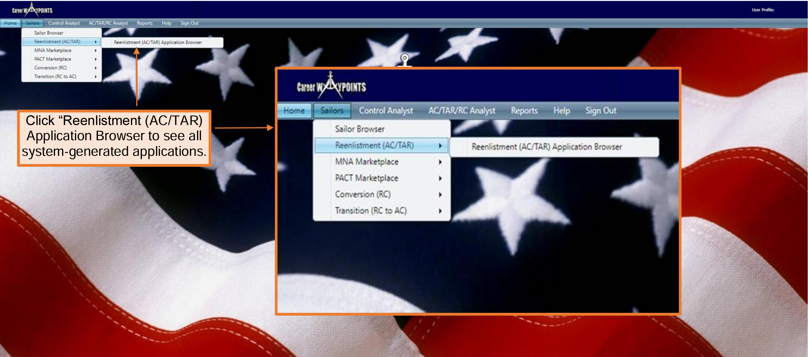
CAREER WAYPOINTS
SELRES Applications
Notes:
FACILITATOR GUIDE:
CWAY Application - Applies to Active Duty and TAR Sailors E3 to E6 with 14 years or less of active service between Active-Duty Service Date (ADSD) and Expiration of Active Obligated Service (SEAOS).
Applications can be submitted under either “Sailors > CWAY Application Browser” or “Sailors > Sailor Browser.”
Most CCCs utilize the “CWAY Application Browser” to submit CWAY applications. All system-generated applications can be found in this section.
AC/TAR Sailors applying for Reenlistment and Conversion apply in My Navy Assignments during their PRD window.

Slide 19
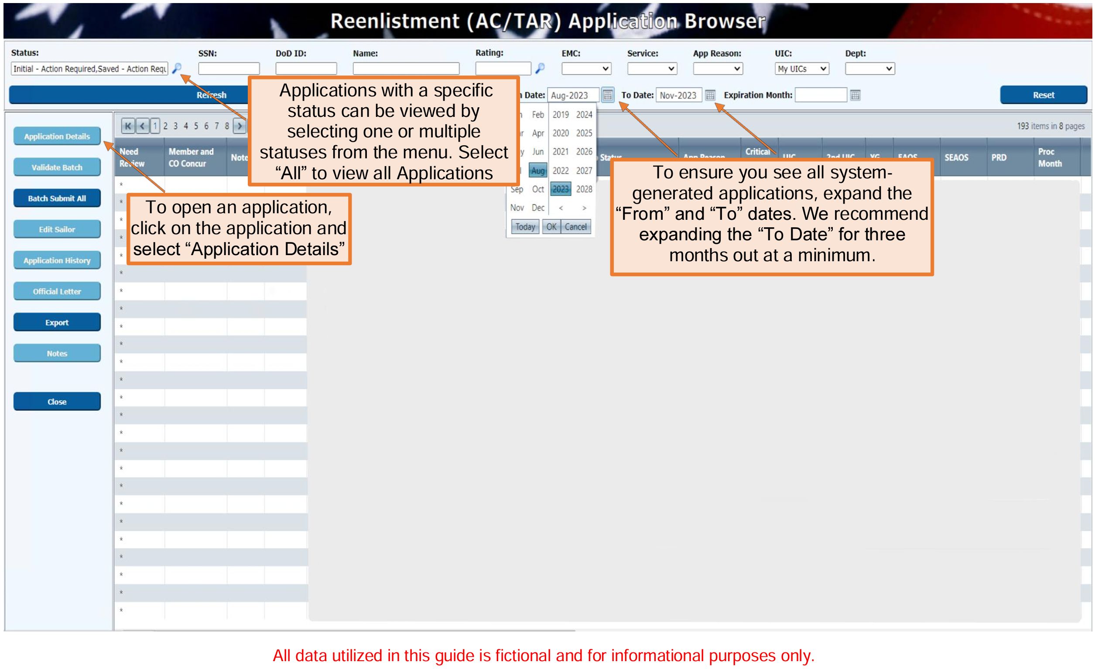
CAREER WAYPOINTS
SELRES Applications
Once approved additional information for transition can be found at https://www.navyreserve.navy.mil/Onboarding/
Notes:
FACILITATOR GUIDE:
Applications can be submitted under either “Sailors > CWAY Application Browser” or “Sailors > Sailor Browser.”
Most CCCs utilize the “CWAY Application Browser” to submit CWAY applications. All system-generated applications can be found in this section.
AC/TAR Sailors applying for Reenlistment and Conversion apply in My Navy Assignments during their PRD window.

Slide 20
CAREER WAYPOINTS
4-2-2 Sailor
NAVADMIN 303/23: Execution of the Selected Reserve Portion of the Military Service Obligation (MSO)
All new enlistment and commissioning contracts executed on or after 1 October 2020 for Sailors under a 4-year Active-Duty service obligation were written to include a minimum of 4 years Active Duty, followed by up to 2 years of SELRES service, and 2 years of Individual Ready Reserve (IRR) service to reach the required 8 years total MSO.

Slide 21
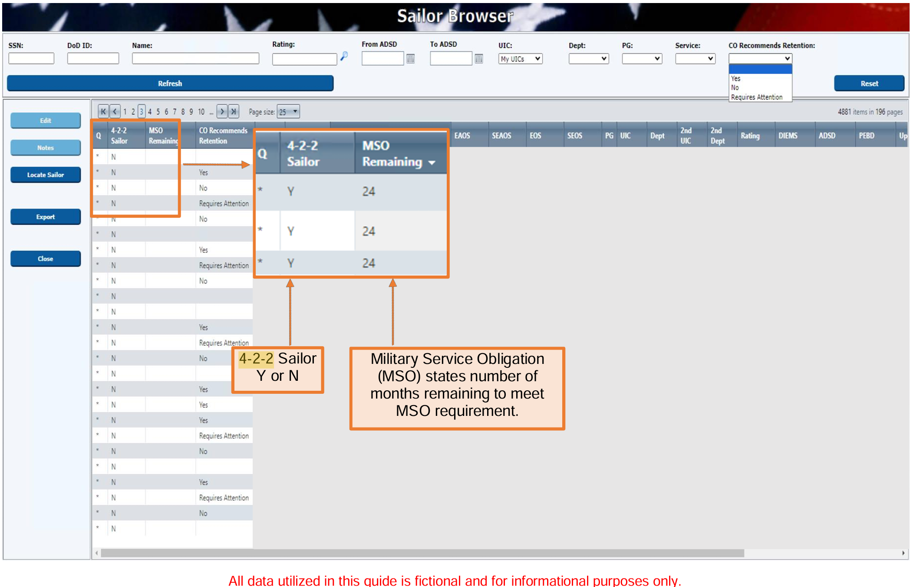
CAREER WAYPOINTS
4-2-2 Sailor
Notes:
FACILITATOR GUIDE:
None

Slide 22
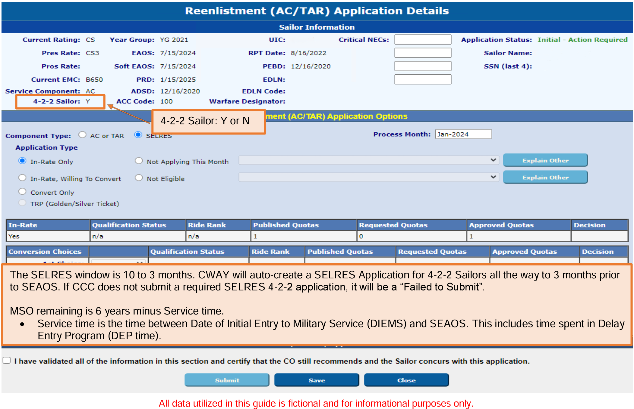
CAREER WAYPOINTS
4-2-2 Sailor
Notes:
FACILITATOR GUIDE:
None

Slide 23
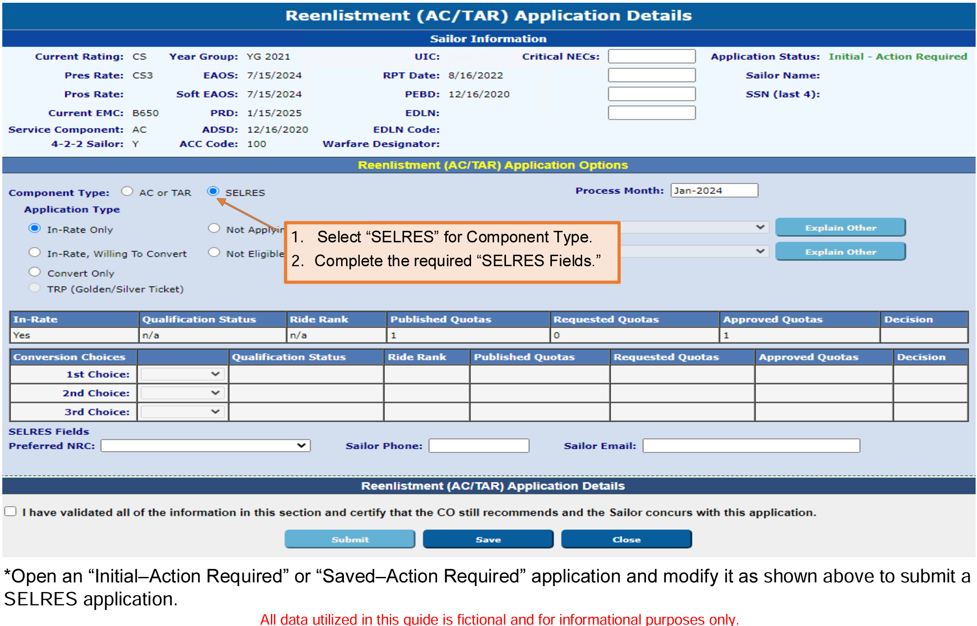
CAREER WAYPOINTS
Non-4-2-2 Sailor SELRES Application
Notes:
FACILITATOR GUIDE:
Per MILPERSMAN 1306-1501, the CCC may contact the SELRES Enlisted Community Manager directly to request a SELRES quota (not a reset) for Sailors within 90 days from SEAOS. Resets for SELRES are NOT authorized during this period.

Slide 24
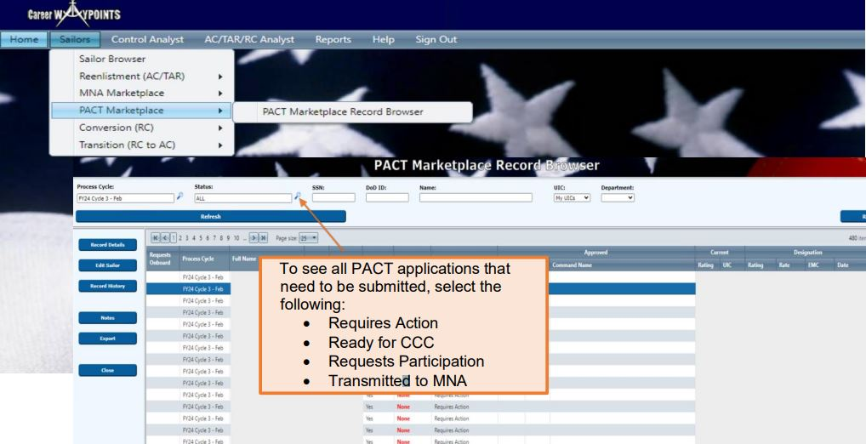
CAREER WAYPOINTS
PACT Marketplace Record
Notes:
FACILITATOR GUIDE:
CWAY receives results from MNA Marketplace of Sailors who have been selected for a set of orders and approved for Reenlistment.

Slide 25
CAREER WAYPOINTS
Status' of PACT Marketplace
Requires Action
Ready for CCC
Requests Participation
Requests Onboard
Declines Participation
Not Eligible
Transmitted to MNA
Approved
Approved-Revoked
Denied
Notes:
FACILITATOR GUIDE:
• Requires Action - The record must be reviewed and updated with the Member’s desire/eligibility.
• Ready for CCC - DCC has entered the Member’s desire, and it is ready for CCC review and submission.
• Requests Participation - Member has requested to participate in PACT Marketplace.
• Requests Onboard - Member can request to remain onboard current command.
• Declines Participation - Member declined to participate in MNA PACT Marketplace.
• Not Eligible - Member is not eligible, for example, Legal/Moral disqualification, performance, etc.
• Transmitted to MNA - Member’s record sent to MNA with all Member’s qualified jobs.
• Approved - Member was approved for a rate and order via the MNA PACT Marketplace.
• Approved-Revoked - Previous approved rate and orders returned and/or revoked.
• Denied - Member’s request was denied during the cycle.

Slide 26
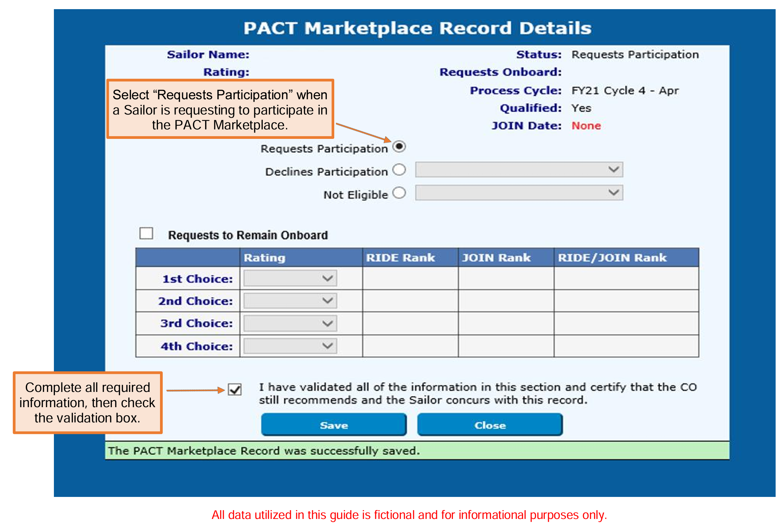
CAREER WAYPOINTS
PACT Marketplace Record
Notes:
FACILITATOR GUIDE:
None

Slide 27
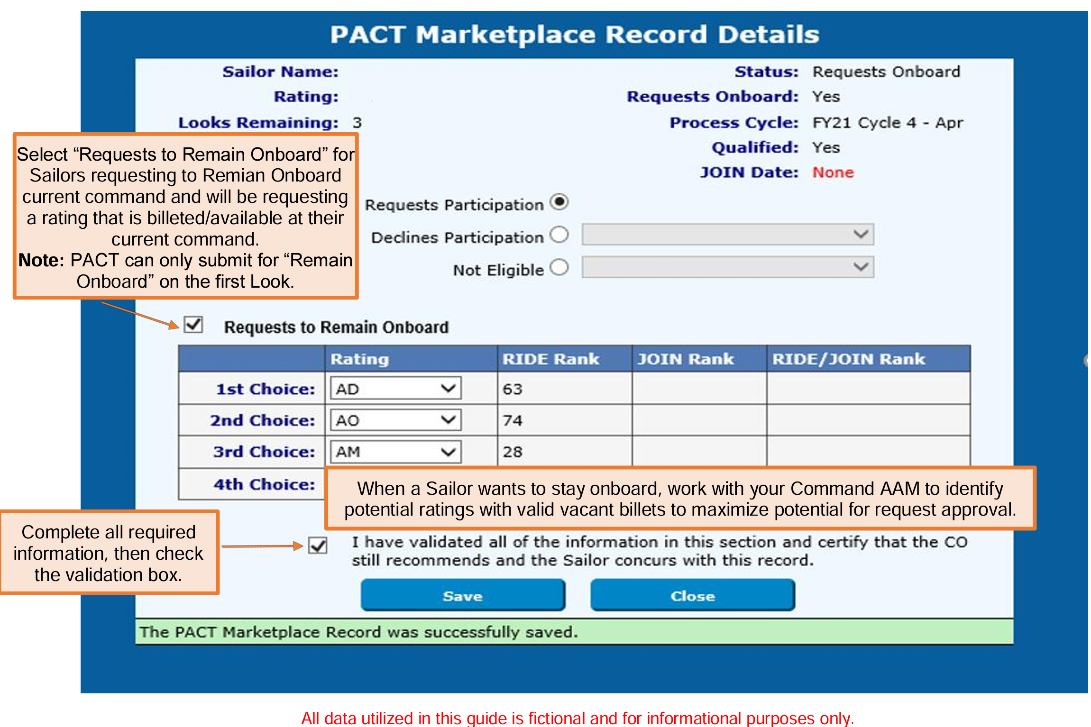
CAREER WAYPOINTS
PACT Marketplace Record (cont.)
Notes:
FACILITATOR GUIDE:
None

Slide 28
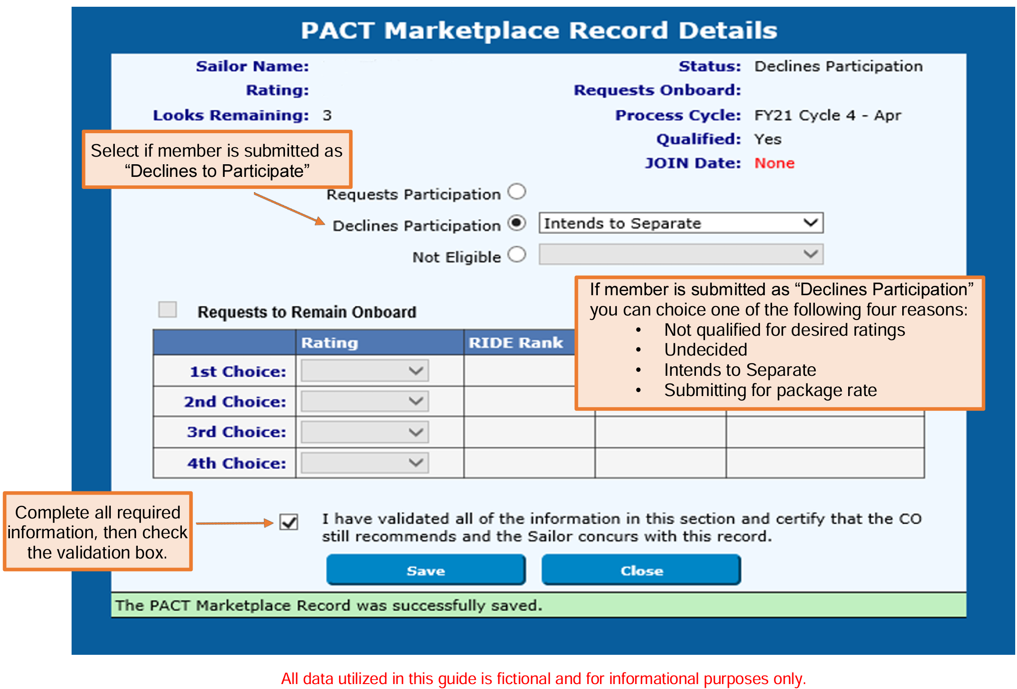
CAREER WAYPOINTS
PACT Marketplace Record (cont.)
Notes:
FACILITATOR GUIDE:
None

Slide 29
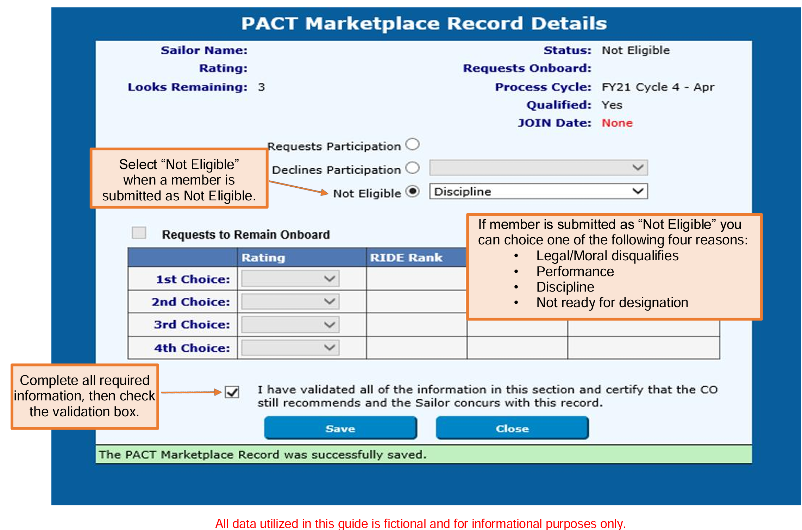
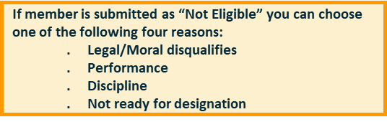
CAREER WAYPOINTS
PACT Marketplace Record (cont.)
Notes:
FACILITATOR GUIDE:
None

Slide 30
CAREER WAYPOINTS
PACT Notes
Be sure to check eligibility status monthly and make updates as soon as possible
  For example, member cannot obtain security clearance due to not being a U.S. Citizen
  Once member becomes a U.S. citizen, this must be updated in CWAY to render member eligible
  Same applies for “declines participation”
  If member changes their mind later, be sure updates are submitted prior to next MNA cycle
Ensure to log into My Navy HR and review the current PACT Marketplace schedule for the fiscal year
  MyNavyHR>Career Management>C-WAY>PACT Designation References: for specific PACT Marketplace Submission schedule
Notes:
FACILITATOR GUIDE:
None

Slide 31
CAREER WAYPOINTS
RC/AC Application Process
Be SELRES at the time of application
  Retired Sailors and Sailors of the Individual Ready Reserve (IRR) are not eligible
Be a satisfactory drill participant
Be designated to a rating
Have completed all requirements to make rate permanent for all temporary rating Reserve affiliation programs
Have completed any mandatory drilling obligations (i.e., NAT Sailors – restrictions are currently lifted)
Notes:
FACILITATOR GUIDE:
CWAY-TRANSITION for RC to AC/TAR
Refer to the latest CWAY User Guide to identify and explain the roles and responsibilities of each entities involved in the process to ensure proper and accurate transition from RC to AC. – 2024 CWAY User Guide (page 77-80)
Have completed all requirements to make rate permanent-Sailors converted in process of transition from RC to AC/TAR

Slide 32
CAREER WAYPOINTS
RC/AC Application Process
Complete operational screening
Be able to meet prescribed enlisted age limitations for continuation set forth in MILPERSMAN 1160-010
Meet physical readiness assessment standards IAW OPNAVINST 6110.1K
Meet requirements for reenlistment per NAVMED P-117, Manual of the Medical Department
Be eligible to reenlist for 48 months without exceeding the High Year Tenure (HYT) program limitations outlined in MILPERSMAN 1160-120 and NAVADMIN 288/22 (Waivers are authorized)

Slide 33
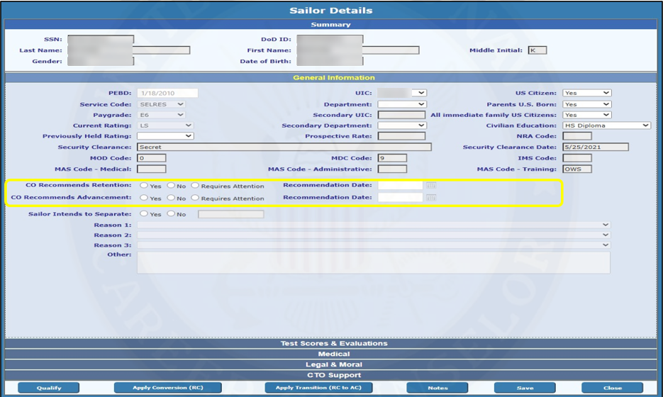
CAREER WAYPOINTS
RC/AC Application Process
Notes:
FACILITATOR GUIDE:
Submitting CWAY-TRANSITION for RC to AC/TAR
To get to this page, go into your Sailor Browser and select the Sailor who desires to convert.
You must double-check the Sailor’s information to ensure he or she will be eligible for all ratings they truly qualify for.
Note- verify MAS Codes

Slide 34
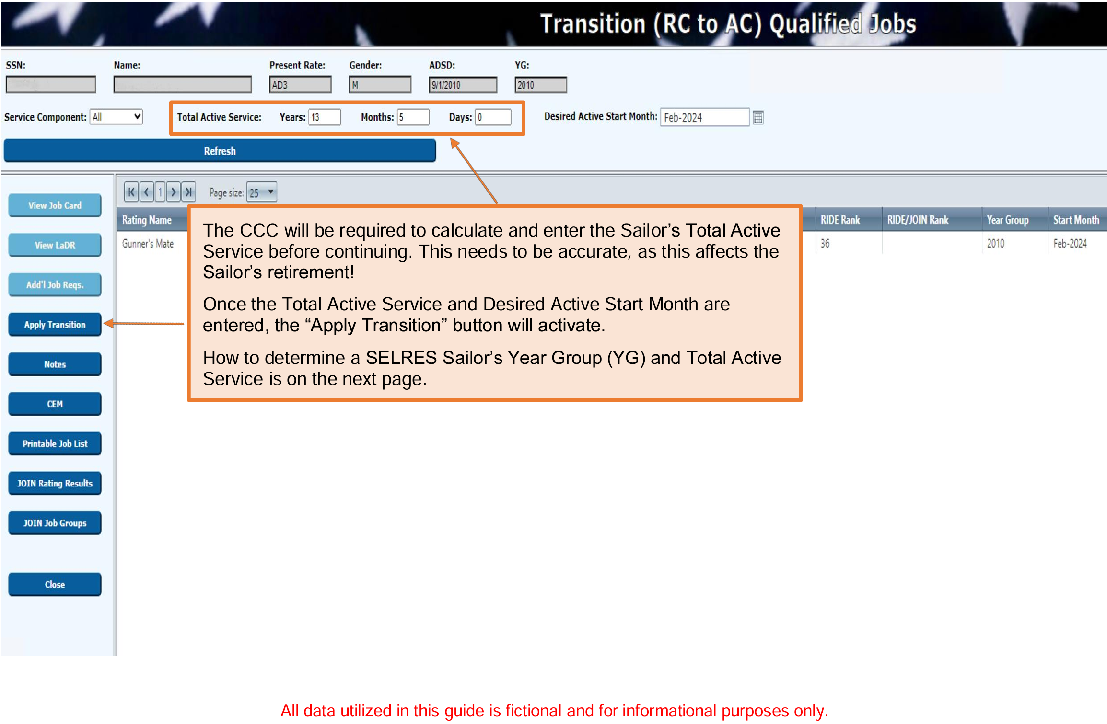
CAREER WAYPOINTS
RC/AC Application Process
Notes:
FACILITATOR GUIDE:
Submitting CWAY-TRANSITION for RC to AC/TAR
The CCC will be required to calculate and enter the Sailor’s Total Active Service before continuing.
This needs to be accurate, as this affects the Sailor’s retirement! Once the Total Active Service and Desired Active Start Month are entered, the “Apply Transition” button will activate.
How to determine a SELRES Sailor’s Year Group (YG) and Total Active Service is on the next page.

Slide 35
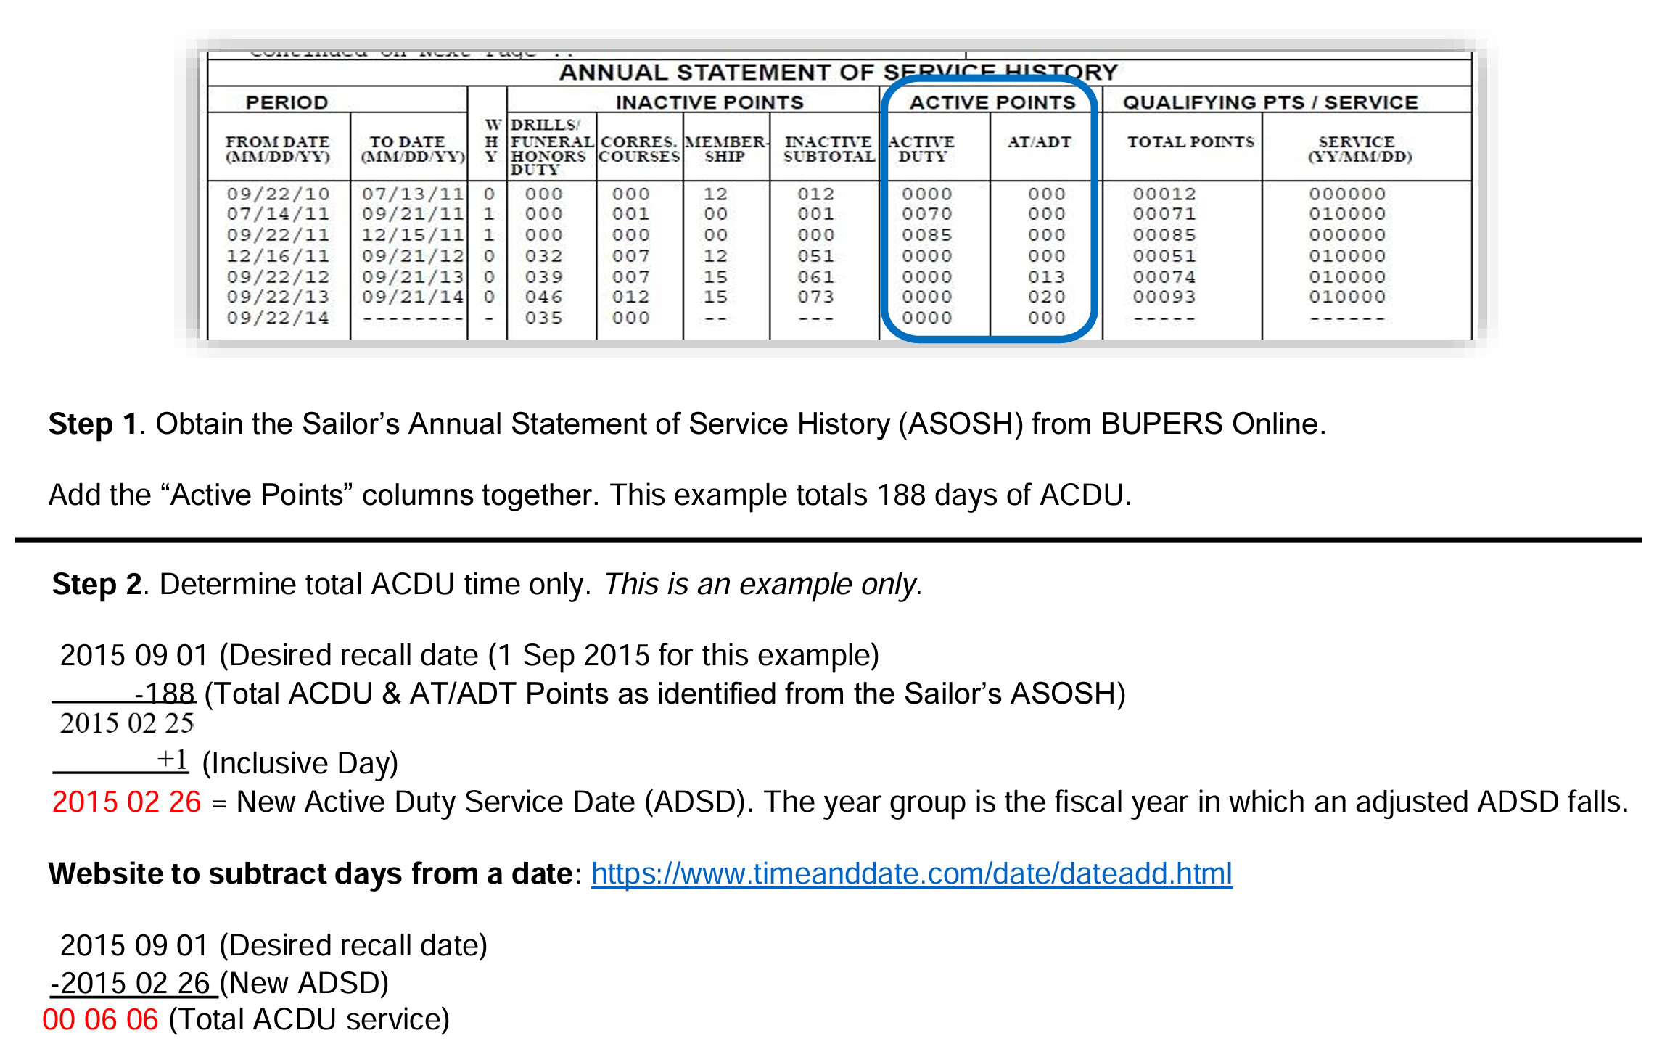
Annual Statement Of Service History
(ASOSH)
Notes:
FACILITATOR GUIDE:
Go over how to use the ASOSH to determine ADS time for RC to AC applications.

Slide 36
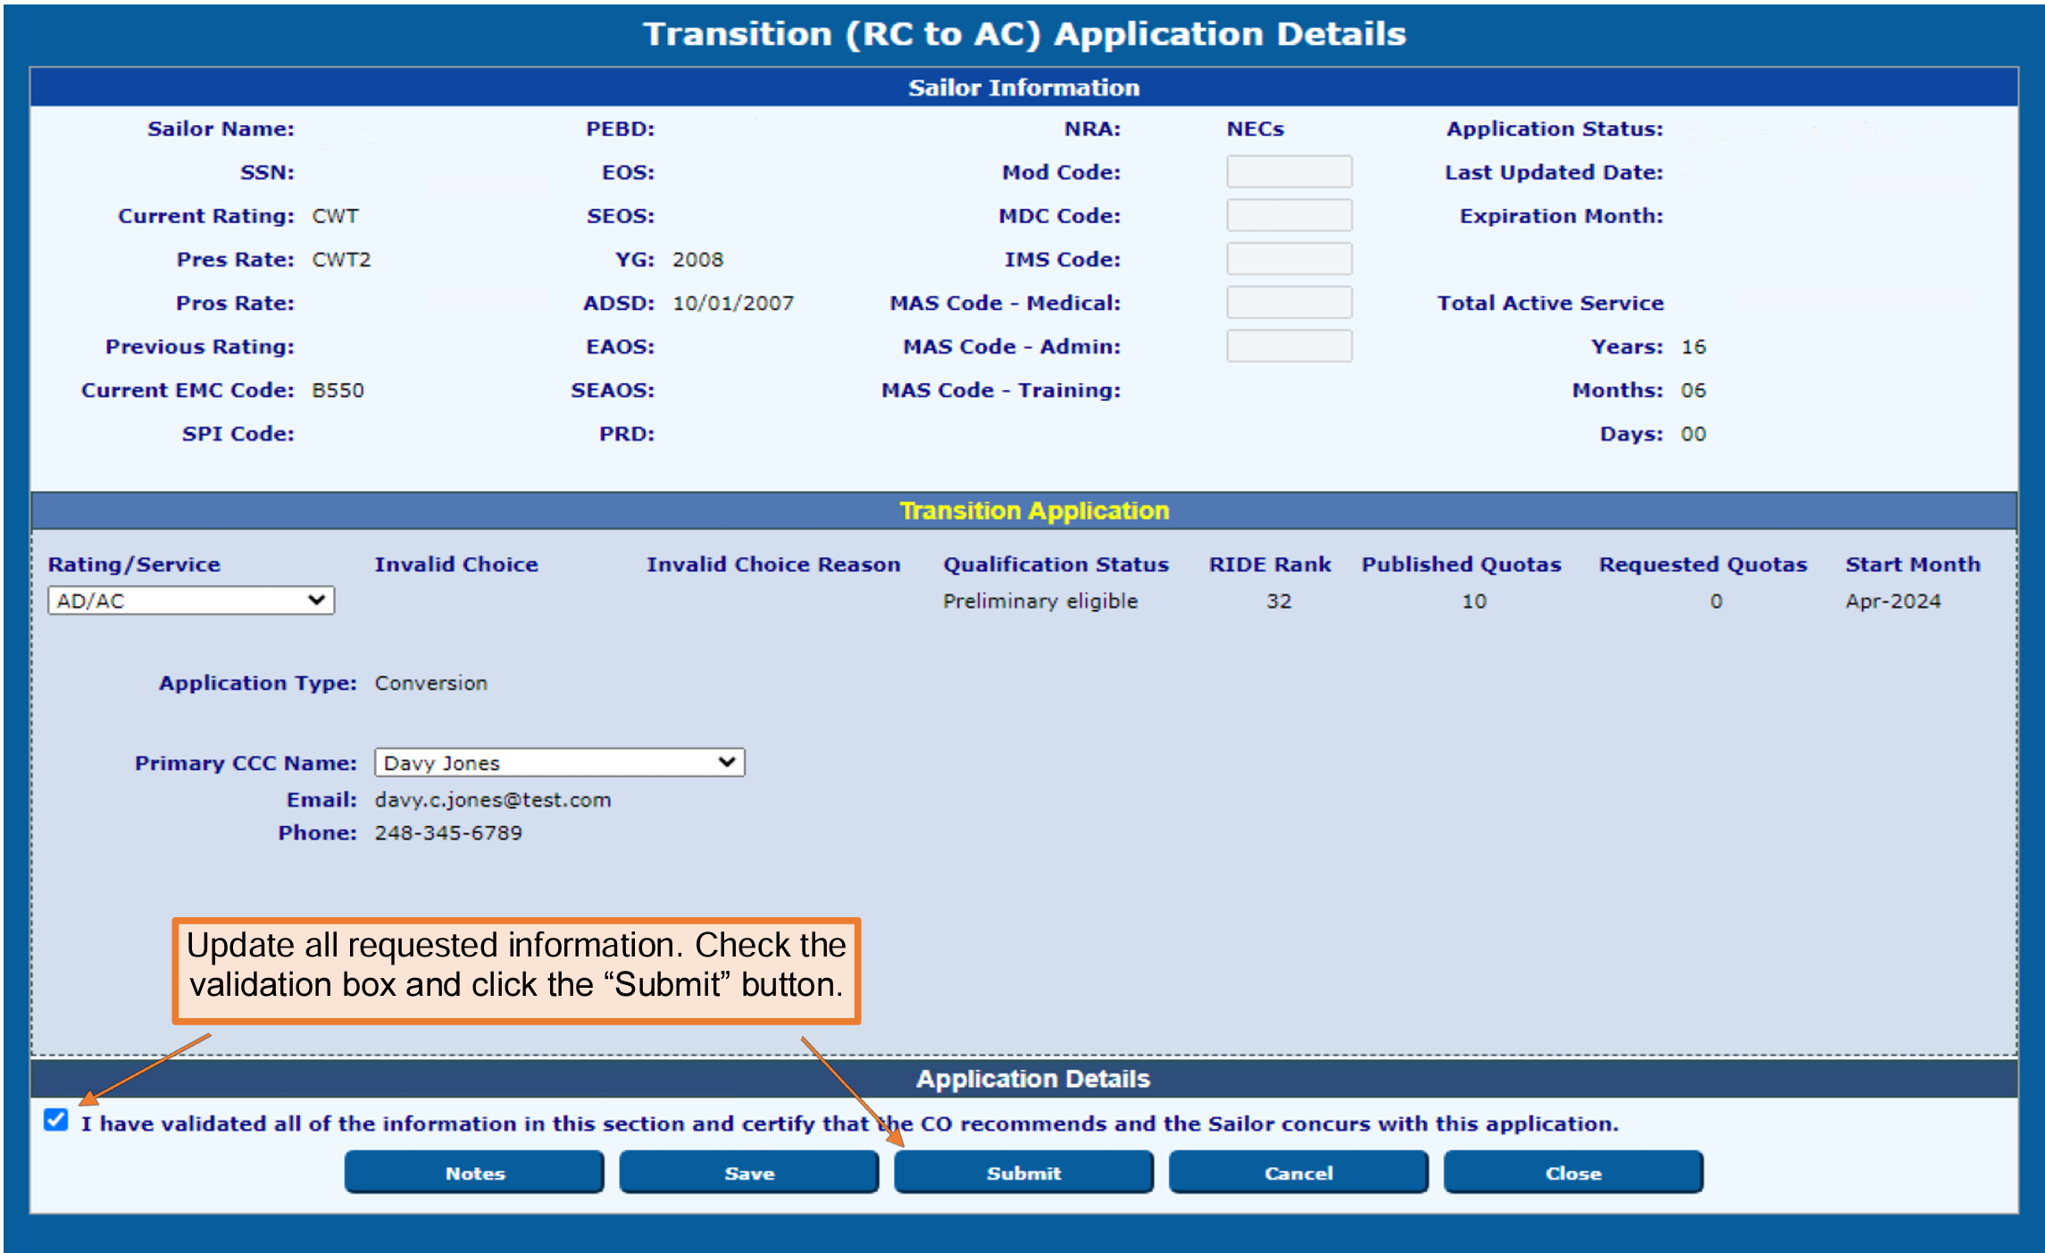
CAREER WAYPOINTS
RC/AC Application Process
Notes:
FACILITATOR GUIDE:
Submitting CWAY-TRANSITION for RC to AC/TAR
Once everything has been validated, click Submit.
To check to the status of your RC to AC/TAR application, head over to the Transition (RC to AC) Application Browser. Ensure to put in the date you applied the Sailor for, or else it will not be listed.

Slide 37
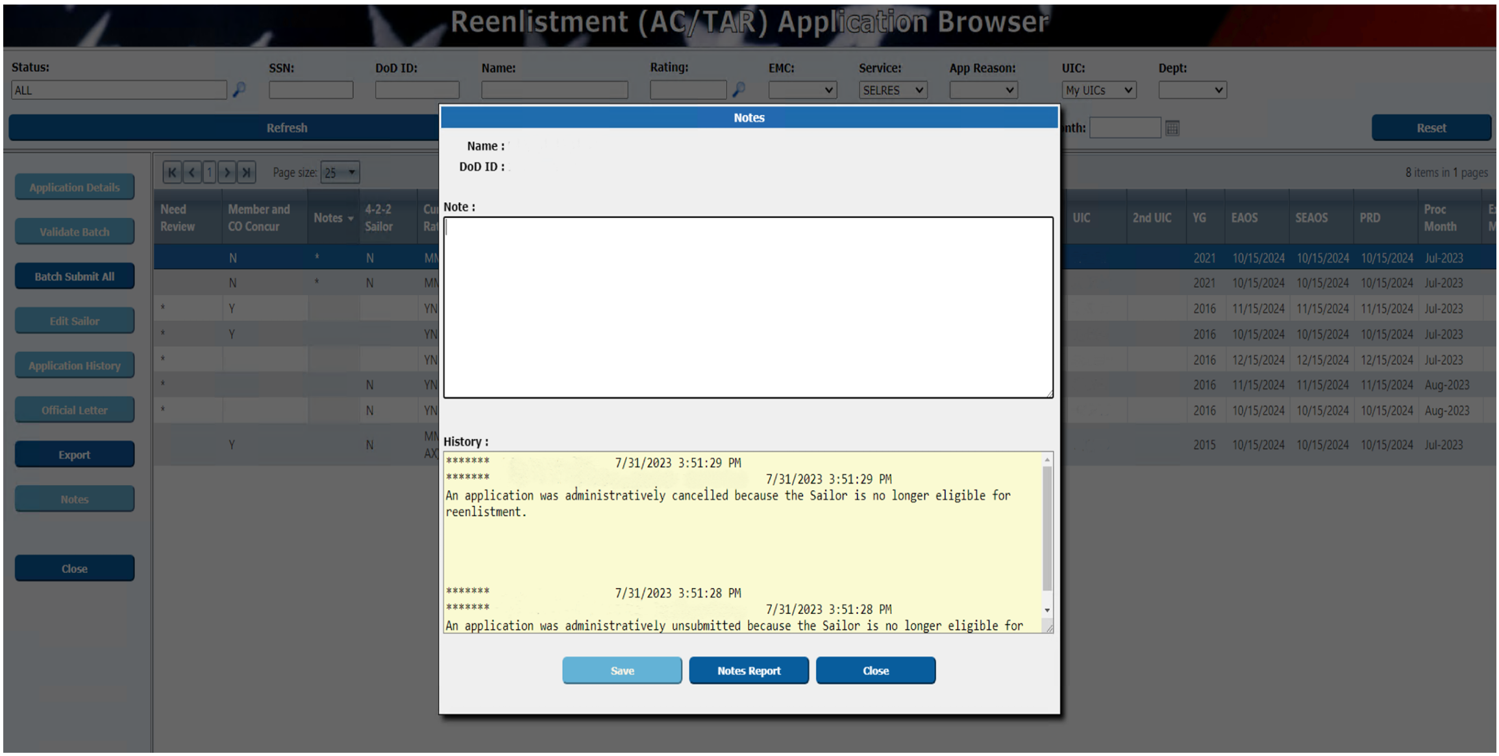
CAREER WAYPOINTS
Notes Section
Notes:
FACILITATOR GUIDE:
The “Notes” section of CWAY is intended as an opportunity to allow communication between the Career Counselors and the Enlisted Community Managers. If the Sailor recently earned his/her warfare device or NEC and it is not reflected in the CWAY “Sailor Details” page, verify receipt and make a note.
1. To either input notes or see if ECM has made any notes (reminder the notes section is where you as the CCC can communicate to the ECM), hover over Sailors, Sailor browser, may need to change page size of 25 to 500 in order to show all Sailors based on the UIC(s) access you have and find the Sailor you are looking for. Click on Sailor's name to get it highlighted in blue, then click on notes. This is where you add or view notes to the Sailor's ECM.
2. Remember this section is your opportunity to communicate with the ECM. Ensure to add notes for applications that are special circumstance, not eligible, and no apply (document everything that affects a change in the Sailor’s application).
3. In this example, the CCC made changes to the Sailor's AFCT scores and annotated the reason why she made said changes.

Slide 38
CAREER WAYPOINTS
Targeted Reentry Program (TRP)
MILPERSMAN 1001-260
COs will recommend high performing Service members meeting TRP criteria for consideration via the command career counselor in Career Waypoints (C-WAY)
Sailor Options:
    Golden Ticket
    Silver Ticket
CCCs will submit TRP applications in CWAY:
    Must be the first CWAY application window and submitted as “Intend to Separate”
  BUPERS-3 is approving authority
Notes:
FACILTIATOR GUIDE:
1. Golden ticket guaranteed expedited return within one year of separation, after one year will automatically be converted to a Silver ticket for one additional year. Silver ticket Sailors are afforded an expedited return within two years of separation, opportunity is subject to Needs of the Navy.
2. Eligibility: applications must be "Intends to separate" from the onset of the SEAOS application. Members in paygrades E4-E6, must have completed their eight year military service obligation (MSO), be under 14 years of service, and not have reached HYT. BUPERS-3 is the approving authority. Must have neither been awarded NJP or court martial within 3 years prior to release. Sailors who are approved and accept TRP will be transferred to the Standby Reserve- Inactive (USNR-S2).
3. After TRP expiration and MSO is not complete, the service member must accept enlistment into the Individual Ready Reserve active status pool (IRR-ASP).

Slide 39
CAREER WAYPOINTS
Targeted Reentry Program (TRP) (cont.)
To be considered, the Sailor must:
    AC or FTS enlisted members in pay grades E-4 to E-6
    Completed their ADSO
    Have not reached 14 years of active service
    Have not reached high-year tenure
    Must be 16-4 months from SEAOS
    Service members awarded a golden or silver ticket must contact the TRP Manager in order to enroll in TRP
    Failure to contact the TRP Manager prior to ACDU separation will result in forfeiture of the awarded ticket

Slide 40
CAREER WAYPOINTS
Targeted Reentry Program (TRP) (cont.)
TRP-approved sailors will be transferred to the Navy Reserve (Standby Reserve Inactive, USNR-S2) for 2 years
  Only required to maintain accurate recall info with PERS-9
  No drilling requirements
After TRP enrollment has expired, if the members MSO has not been completed, they will remain in the Individual Ready Reserve active status pool (IRR-ASP) or USNR-S2 until the completion of their MSO
Military Service Obligation: For a period of 8 years from the date of enlistment, appointment
  Completed between Active Duty, Selective Reserves or Individual Ready Reserves
Notes:
FACILITATOR GUIDE:
The TRP module supports the Targeted Reentry Program through which Active and Full-Time Support Sailors indicate their intention to separate at the end of their current enlistment contract and request authorization for deferred reenlistment. When approved, Sailors may reenlist within a specified period in a highly streamlined process. Submission is constrained by quota availability and other factors.

Slide 41
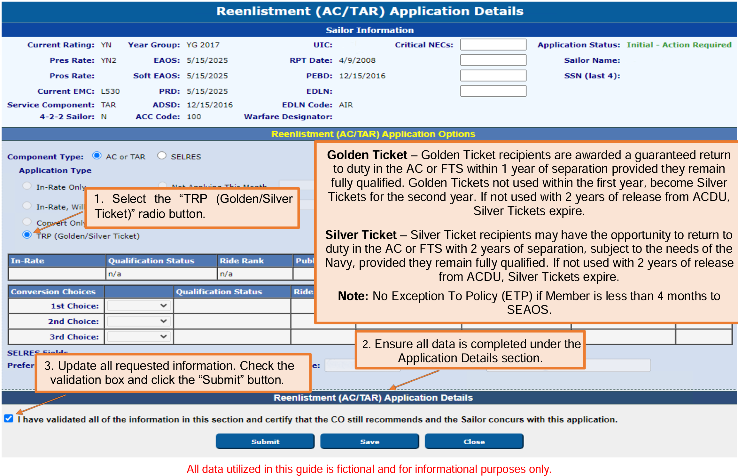
CAREER WAYPOINTS
Targeted Reentry Program (TRP) Application
Notes:
FACILITATOR GUIDE:
The TRP module supports the Targeted Reentry Program through which Active and Full-Time Support Sailors indicate their intention to separate at the end of their current enlistment contract and request authorization for deferred reenlistment. When approved, Sailors may reenlist within a specified period in a highly streamlined process. Submission is constrained by quota availability and other factors.

Slide 42
CAREER WAYPOINTS
Targeted Reentry Program (TRP) Notes
Golden ticket recipients- guaranteed to Active Duty
Silver ticket- subject to needs of the Navy
Will coordinate with detailer to negotiate PCS orders and recall timeline
Must obligate service for 48 months upon return to active service
If a Sailor elects TRP then changes decision for SELRES, Sailor will need to submit 1306/7 for SELRES quota

Slide 43
CAREER WAYPOINTS
Modules
Job Opportunities in the Navy (JOIN)
  Allow Sailors to complete survey to determine career interest
  Ranks each job based on survey inputs
Career Exploration Module (CEM)
  Great tool when conducting conversion CDBs
  Allows counselors to identify and explain why a Sailor did not qualify for a particular rate
CWAY Sailor Self-Service
  Sailors can access JOIN results and CEM (after being qualified)
  Tool for allowing Sailors their own access to see their career opportunities
Notes:
FACILITATOR GUIDE:
1. Join is a job interest assessment tool that supports recruits and Sailors making rating entry decisions.
2. CEM assists in determining correctable deficiencies that would otherwise render Sailors ineligible for desired ratings (e.g., retake the Armed Forces Classification Test (AFCT)- the in-service version of the ASVAB). The CEM module also provides Sailors with a roadmap for each job they qualify for.
3. Both of the above modules, can be found in the CWAY self-service system via BOL (under my opportunities and my interest).

Slide 44
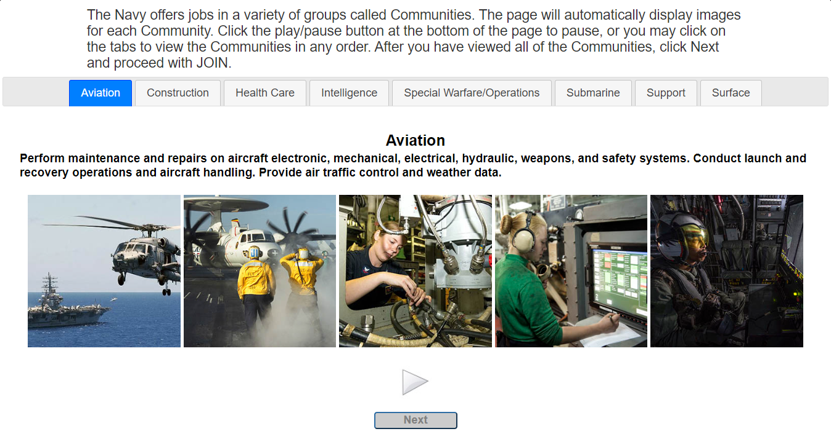
Job Opportunities In the Navy
(JOIN) Survey
Notes:
FACILITATOR GUIDE:
Access via BOL. Great tool to assess interest and ranking of rates.
Encourage PACT Sailors to use to assist with helping decide which rates they might want to choose. Not each rate is available at their current command.

Slide 45
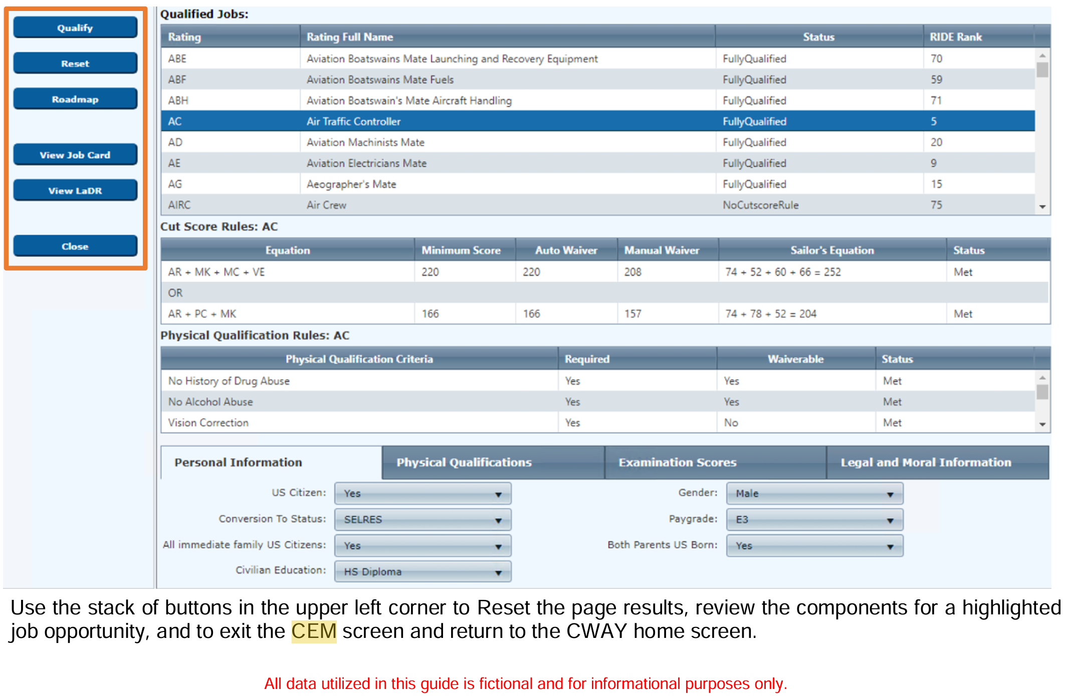
CAREER WAYPOINTS
Career Exploration Module (CEM)
Notes:
FACILITATOR GUIDE:
Review CEM module
• Qualify populates the Qualified Jobs field after you have entered your selections in the Personal Information, Physical Qualifications, Examination Scores, and Legal and Moral Information tabs at the bottom of the window.
• Reset resets your entries under the Personal Information, Physical Qualifications, Examination Scores, and Legal and Moral Information tabs at the bottom of the window.
• Roadmap lists the Supplemental Qualifications, Examinations and Training Requirements Checklist, Requirements Not Met, and Qualification Steps necessary to qualify for the desired rating.
• Job Card gives a complete overview of the selected rating, showing the career path, job duties, working environment, and related civilian jobs.
• LaDR (Learning and Development Roadmap) outlines training and education milestones for each rating at each pay grade to optimize your Navy career path.
• Close exits the CEM and closes the window.

Slide 46
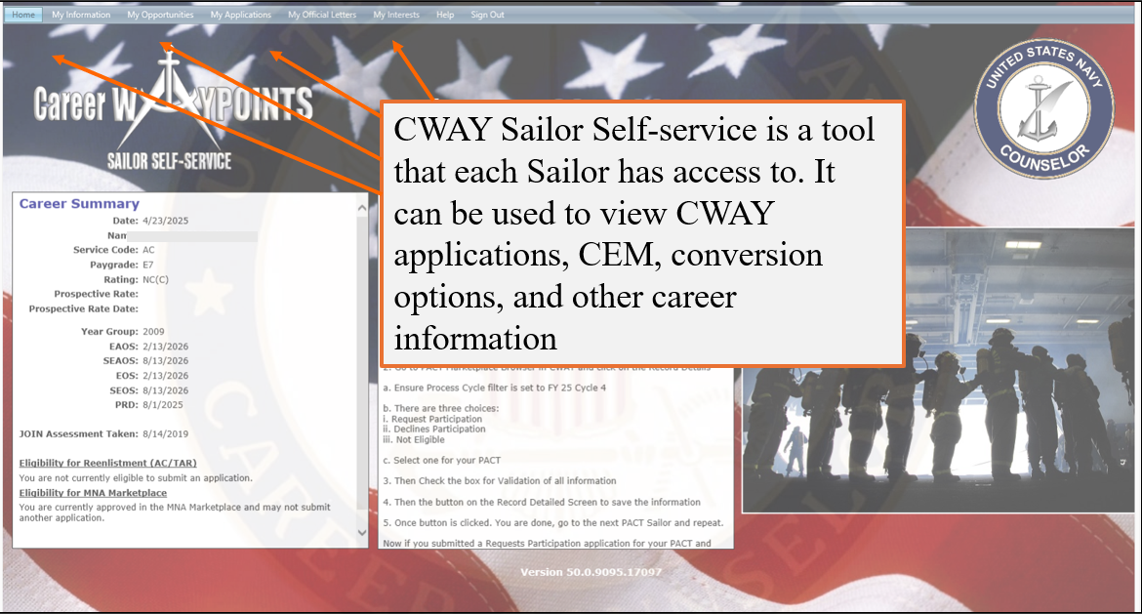
CAREER WAYPOINTS
Self-Service

Slide 47
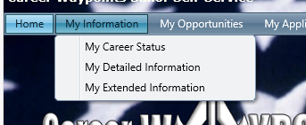
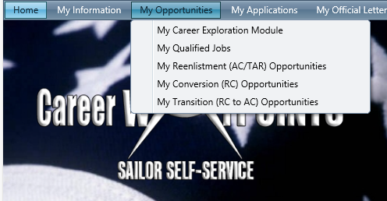
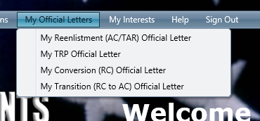
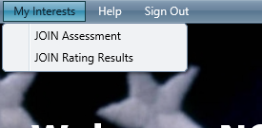
CAREER WAYPOINTS
Self-Service
Sailors always have access to this information
Great for PACT Sailors and Sailors looking to convert
Great for lateral conversions and SELRES conversions opportunities

Slide 48
CAREER WAYPOINTS
Dept/Div CC Responsibilities
Platform/Command specific:
Gain access to CWAY to complete the following:
  Track when Sailors are approaching CWAY/PACT Marketplace window
  Assist CCC in qualifying all members within Dept/Div using NAVPERS 1040/4
  Give Sailors guidance for submitting OBLISERV request in MNA
  Assist CCC with updating career intentions in CWAY
  Communicate with CCC if/when career intentions change
  Properly report/document CWAY applications entered on each monthly report
  Know how to help members navigate through functions in CWAY Sailor Self-Service

Slide 49
Knowledge Check
Which paygrades require CO's recommendation for retention to apply for OBLISERV in MNA?
What is the submission window for a Sailor to apply for TRP?
What status would the CCC choose if a PACT sailor wanted to remain at their current command?
What 3 modules can Sailor's access in CWAY for more knowledge on career opportunities?

Slide 50
Summary and Review
In this lesson we discussed:
  Purpose of Career Waypoints
  Personnel impacted by the Career Waypoints process
  Career Waypoints process
  Career Waypoints options provided to the Sailor
  Career Waypoints timeline requirements
  PACT Marketplace process
  Quota Validation
  TRP Program
  CWAY Sailor Self-Service

Slide 51
Questions?

